Slide 1
_{Car Price Prediciton}
Web Scraping / regression project presentation
Ruzaina Khan

Slide 2
Problem Statement
With the covid 19 impact in the market, we have seen lot of changes in the car market. Now some cars are in demand hence making them costly and some are not in demand hence cheaper. One of our clients works with small traders, who sell used cars. With the change in market due to covid 19 impact, our client is facing problems with their previous car price valuation machine learning models. So, they are looking for new machine learning models from new data. We have to make car price valuation model.

Slide 3
This project contains two phase

Slide 4
Data Collection Phase
You have to scrape at least 5000 used cars data. You can scrape more data as well, it’s up to you. more the data better the model
In this section You need to scrape the data of used cars from websites (Olx, cardekho, Cars24 etc.) You need web scraping for this. You have to fetch data for different locations. The number of columns for data doesn’t have limit, it’s up to you and your creativity. Generally, these columns are Brand, model, variant, manufacturing year, driven kilometers, fuel, number of owners, location and at last target variable Price of the car. This data is to give you a hint about important variables in used car model. You can make changes to it, you can add or you can remove some columns, it completely depends on the website from which you are fetching the data.
Try to include all types of cars in your data for example- SUV, Sedans, Coupe, minivan, Hatchback

Slide 5
Model Building Phase
After collecting the data, you need to build a machine learning model. Before model building do all data pre-processing steps. Try different models with different hyper parameters and select the best model.
Follow the complete life cycle of data science. Include all the steps like.
1. Data Cleaning
2. Exploratory Data Analysis
3. Data Pre-processing
4. Model Building
5. Model Evaluation
6. Selecting the best model

Slide 6
Understanding the problem statement
So, In our Problem Statement One of our clients works with small traders, who sell used cars. Client Want to know with the change in market due to covid 19 impact, our client is facing problems with their previous car price valuation machine learning models from a new data . So, here we have to scrap the data data from used car selling website like car 24 , car dekho ,olx and other site .
So , Here we have to scrap the data from any of the given website and build a machine learning model which can predict the Price of Used Car.
And we have to scrap the data for different different Location
For scraping the data we use Car24.com

Slide 7
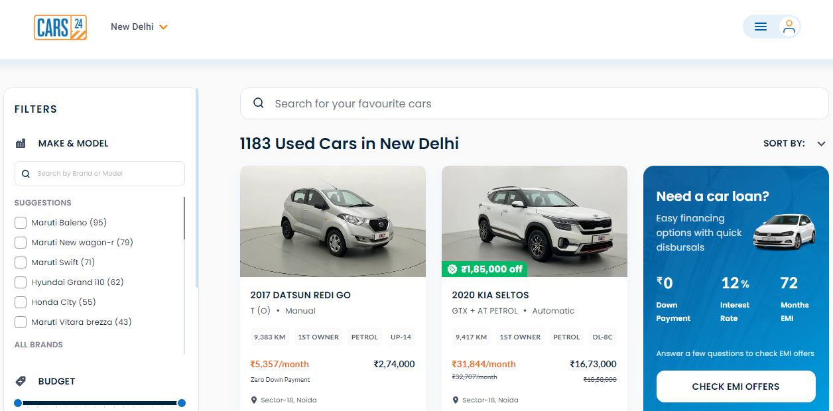
Car24.com

Slide 8
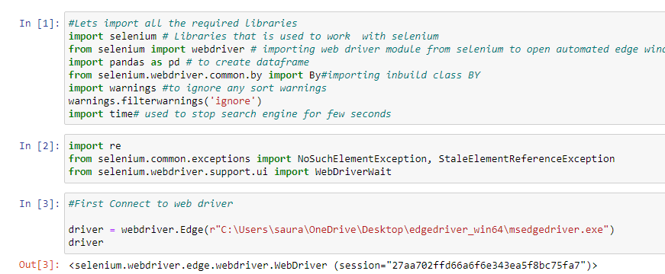
For Scraping We USED Selenium web driver

Slide 9
Goal
Scrap the data from website and Combine all the data and build Machine Learning Model.

Slide 10
Scraped data
Brand -> Brand of the Car Like (Maruti , Hyundai , Honda and etc)
Year_Model -> Which Year Can Car is Buy
Car_Name -> Name of the Car Like (Alto , Verna , Thar and etc)
Model -> Model of the Car Like (Alto K10 LXI , Santro GLS , Swift VXI and etc)
Variant -> Mannual or Automatic
driven_kilometer -> How much KM Car run by the owner.
Fuel -> Which type of Fuel is Used by a Car Like (Petrol ,Diesel , CNG Or EV)
number_of_owners -> How Many time car sell Like (1st Owner ,2nd Owner )
Price -> Price of the Second Hand Car (It’s a Target Variable )
Location -> From Which Location Car is Selling

Slide 11
About Dataset
Here , We have 8774 Rows and 16 Columns (6 Columns are Unncessory)
This dataset contain null values 1264 . We drop all null values .
This Dataset Contain 4 Duplicated Value . We Drop the duplicates because we we think that for showing in top of the website many persons are update daily same to show in front of the website .
All the Columns has Object data type . And Year_Model is Float Data Type. And we have to convert Price and KM to a Float Data Type.

Slide 12
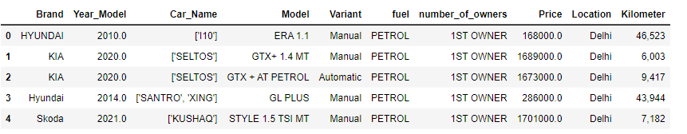
Lets look into a dataset

Slide 13
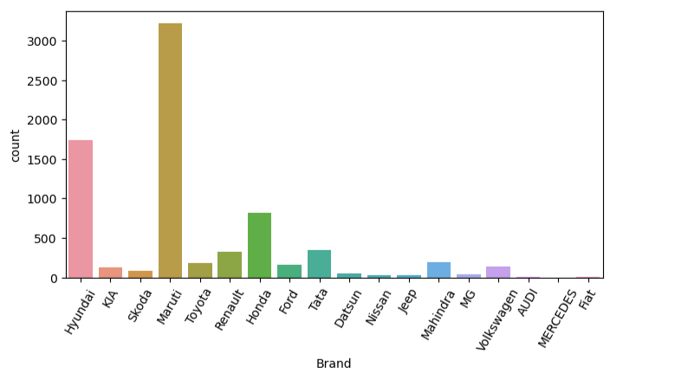
EXPLORATORY DATA ANALYSIS
Univariate Analysis - > Lets Plot Brand
Here, We can see that Maximum car Come from Maruti then Hyundai . and Less car come from SKODA , Mercedes , Fiat .

Slide 14
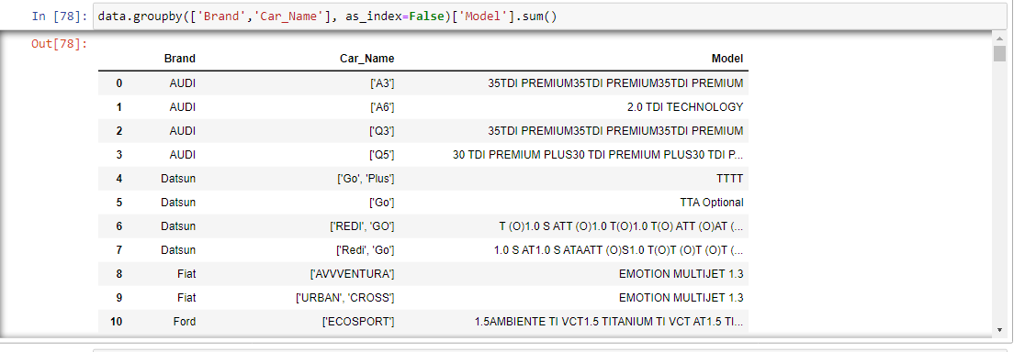
Group by brand and car name
So , Here we find that
Maximum sell car come
From Maruti Like – Dzire,
Alto, Baleno , Celerio,Swift
,Alto K10 and Zen Estilo , Van, Vitara Brazza, Ignis ,
Ertiga and Many More.
Hyundai -> Grand i10 ,Elite i20, Verna , Creta and
Many More.

Slide 15
Lets Check most sell car by brand
Ford -> Eco Sport , Endeavour .
Honda -> Amaze , Brio , City ,Civic , Wrv .
Hyundai -> Creta, Elite , Eon , Grand i10, i20 Active, Elantra , Santro Xing , Venue, Verna , Xcent .
Kia -> Seltos , Sonet,
MG -> Hector .
Mahindra -> Bolero, Scorpio , Thar , XUV 300 , KUV 100 .
Maruti -> – Dzire,Alto, Baleno , Celerio,Swift,Alto K10 and Zen Estilo , Van, Vitara Brazza, Ignis, Ertiga ,Scross. Dezire , Swift Dezire, Ertiga , Eeco, Spresso.
Nissan-> XLX6, Magnite , Micra Activa, Captur

Slide 16
Reneault -> Duster , KWID , Kiger , Triber .
Skoda -> Rapid , Slavia , Octavia, Kushaq .
Tata -> Harrier, Hexa , Nexon , Safari, Tiago , Tigor , Zest.
Toyota -> Etios , Fortuner , Glanza, INNOVA Crysta, Etios, Urban Cruiser.
VolksWagon -> Polo, Ameo, Vento.
These Brand and Car Name are most sell in india as per the Data Says from Car 24.
For More Info -> Jupyter Notebook Cell Number - 89

Slide 17
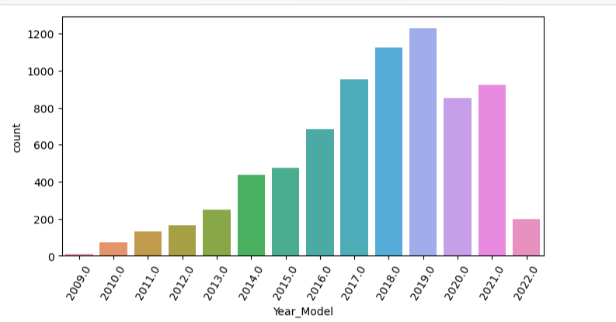
Lets plot Year Model
Here, We can see that maximum car sell from 2019 then 2018 and less car come from 2009.

Slide 18
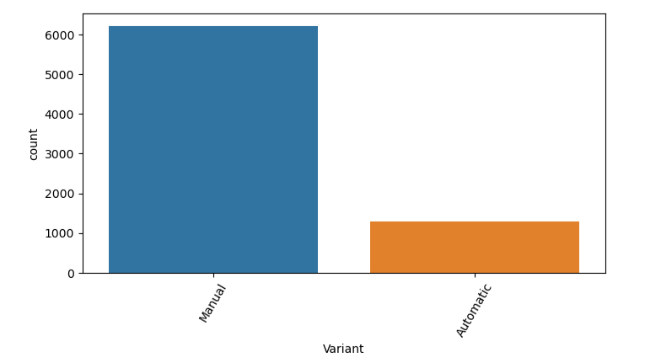
Lets plot Variant
Here , We can see that Maximum car is Manual and Less are Automatic .

Slide 19
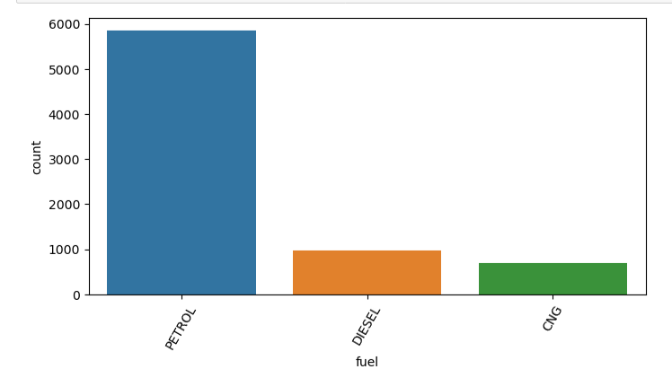
Lets plot fuel
Here , We can see that Maximum car are petrol then Diesel then CNG

Slide 20
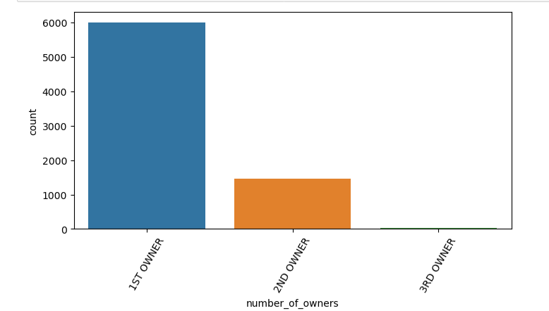
Lets plot number of owners
Here , We can see that Maximum car are from 1st Owner then 2nd Owner then 3rd

Slide 21
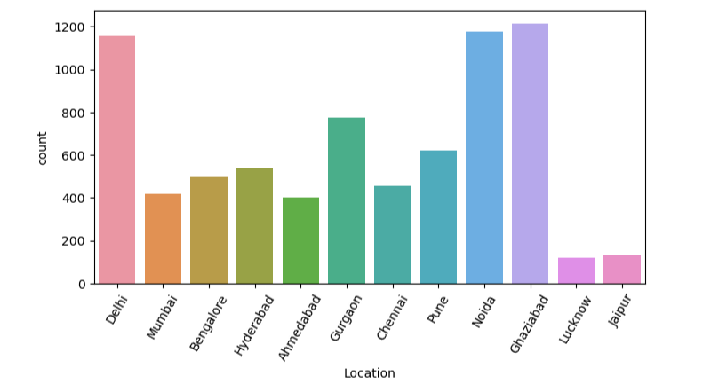
Lets plot Location
Here , We can see that Maximum car sell from Ghaziabad then Noida then Delhi and Less Car sell From Lucknow

Slide 22
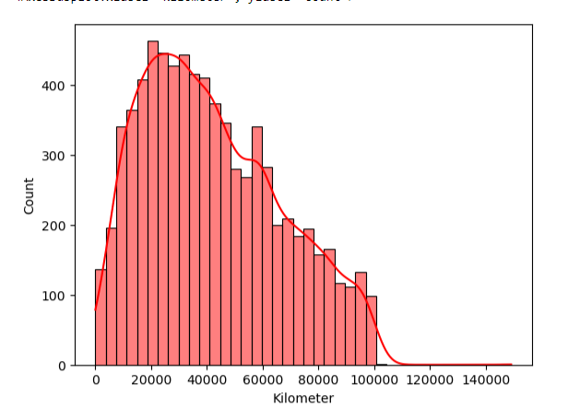
Lets plot Kilometer
Here , We can see that Maximum car are run 20000 to 60000

Slide 23
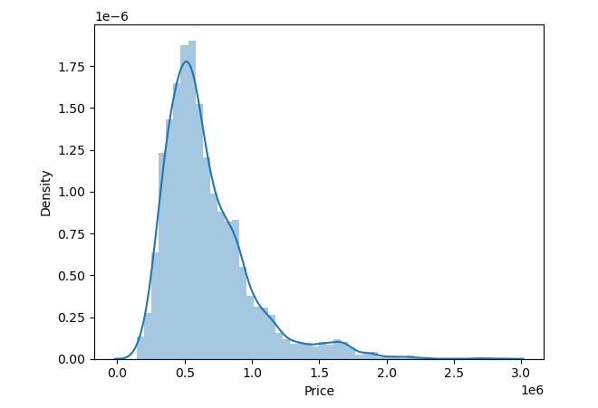
Lets plot Price
Here We can see that the Price Columns is Normally Distributed

Slide 24
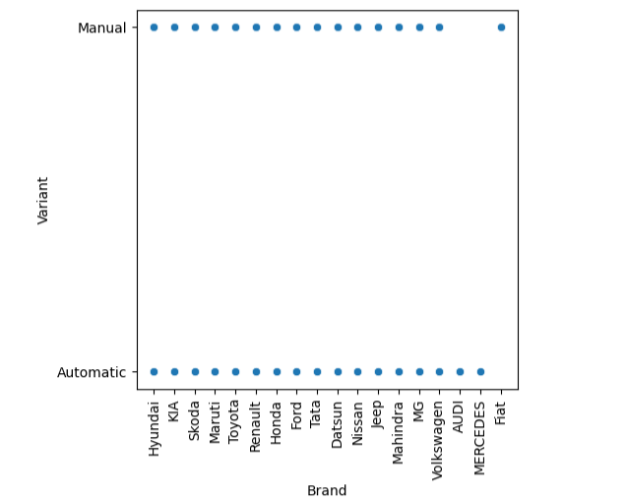
Bivariate analysis
Lets plot Brand Name With Variant
Here , We can see that max
Companies are giving both car
Mannual and Automatic except
Audi Mercedes Don’t Give Mannual
Car and Fait Don’t Give Automatic
Car.

Slide 25
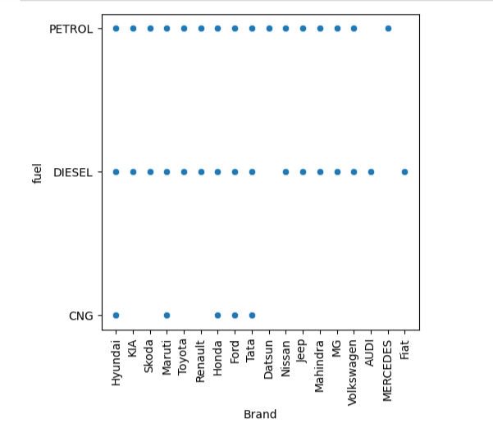
Lets plot Brand Name with Fuel
Here we can see that maximum car company give Diesel and Petrol Car and
CNG car gives only Hyundai , Maruti , Honda , Ford and Tata .

Slide 26
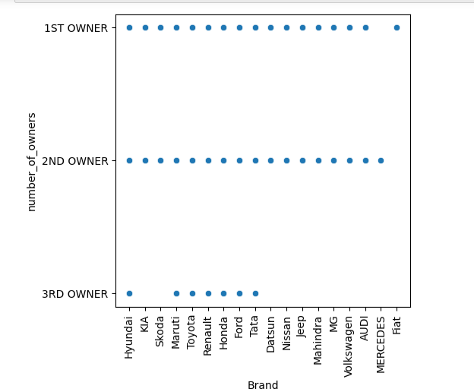
Lets plot Brand Name with number of owners
Here , We can see that Maximum car sell by
First owner then Second Owner then Third Owner . Less people sell 3rd Hand car . Only selected company car are here for selling.

Slide 27
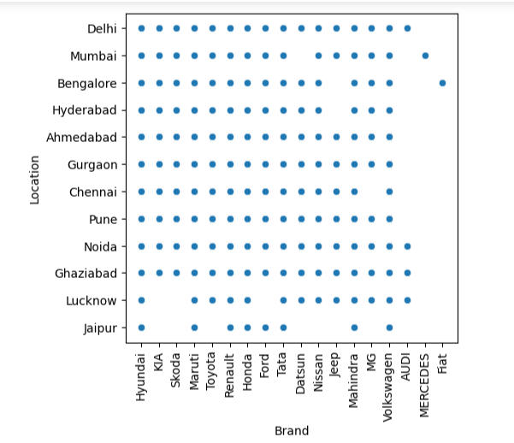
Lets plot Brand Name with Location
Her We see Car Brand name and Location where car is selling . So , its not giving the info about price . But we see here in all places in india all most all company car running.

Slide 28
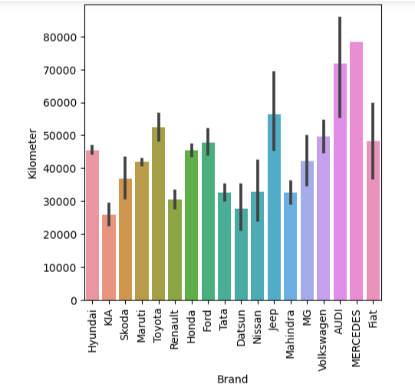
Lets plot Brand Name with Kilometer
Here , We can see that . If the car brand is luxury the
Car is also running more.like Audi , Mercedes .
And for our Middle class We can see that Maruti ,
Hyundai , Kia , Toyota , Honda , Tata and etc.
This much car Brand Are also good running in india.

Slide 29
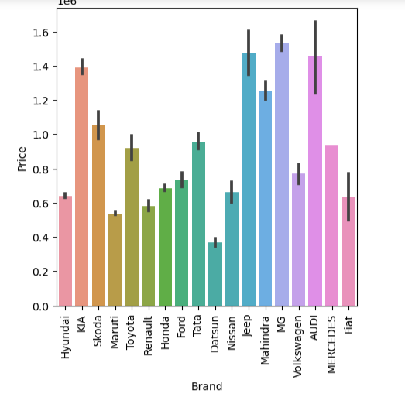
Lets plot Brand Name with Price
Here we can see that Price accrding to brand
Audi , Kia , Volkswagen , JEEP ,Mahindra are costy in Resale Value . And lest are little bit less from the above brands

Slide 30
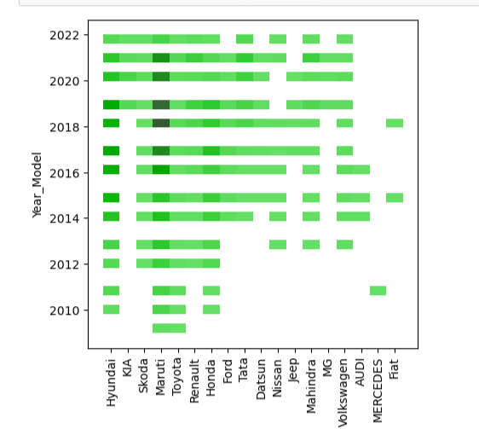
Lets plot Brand Name with Year Model
Here , We can see that Maximum car come
From 2014-2022 year model . And less car come
2009-2013 .

Slide 31
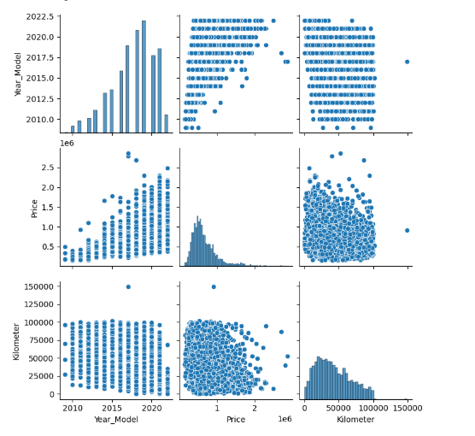
Multivariate analysis
Pairplot for Continious Variable

Slide 32
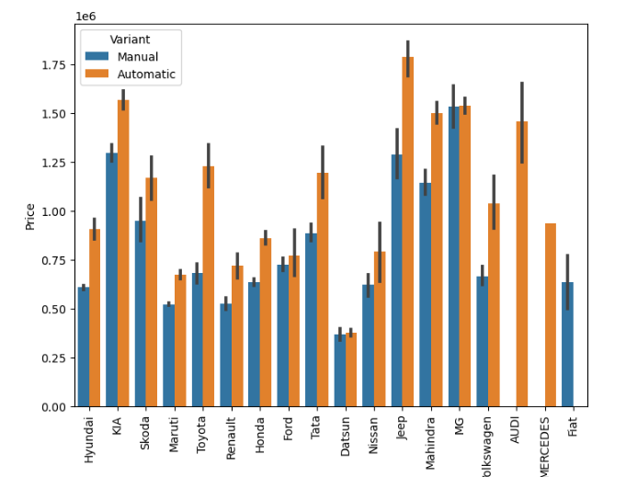
Lets plot Brand With Price and Variant
Here , We cam see that as the price increases the Automatics are also increase.and almost all the company automatic car are most costly to Mannual .

Slide 33
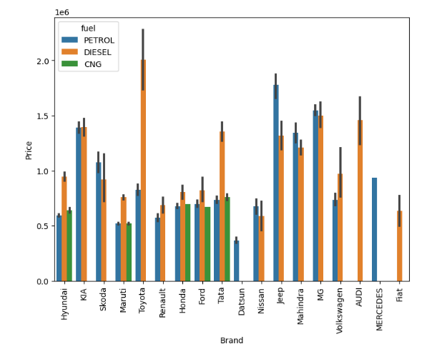
Lets plot Brand With Price and Fuel
Here , We can see that Toyota have costly Diesel Car and Mercedes have only Petrol car and Fiat have only Diesel Car. And Datsun, Nissan , Jeep , Mahindra , MG , Volkswagon , Mercedes and Fiat not give CNG Option.
And left car brand name is give all the fuel type car. And we can also see that Diesel Engine car are costly

Slide 34
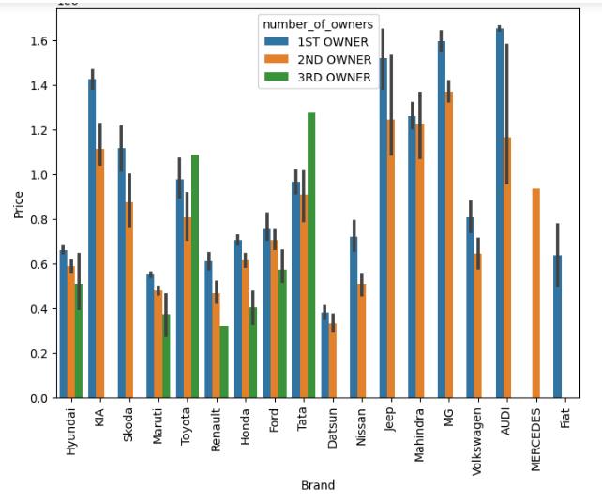
Lets plot Brand With Price and Number of Owner
Here we can see that maximum car come from 1st owner and we can see that only Toyota and tata
Have costly car even it’s a third owner car.

Slide 35
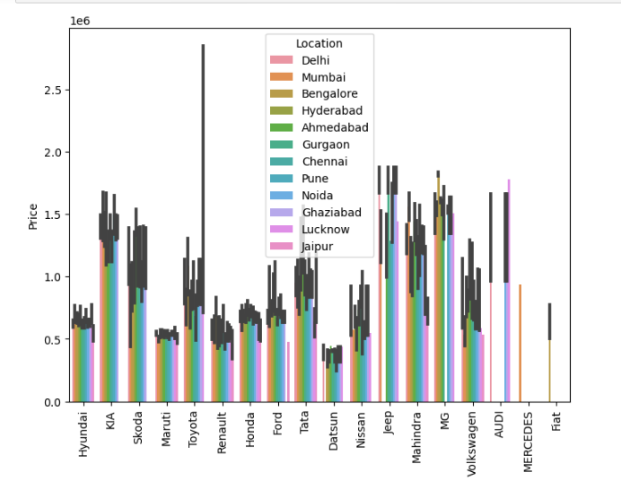
Lets plot Brand With Price and Location

Slide 36
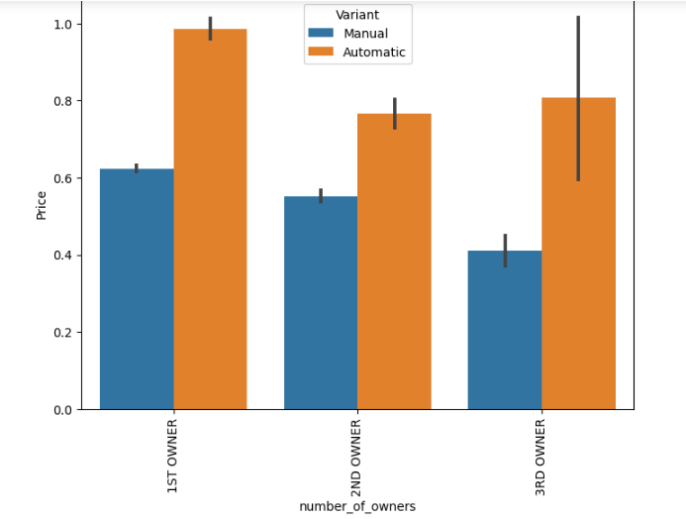
plot Number ofOwners With Price and Variant
Here we can see that Automatic care are more sell by Owners .and Price is also high for automatic car.

Slide 37
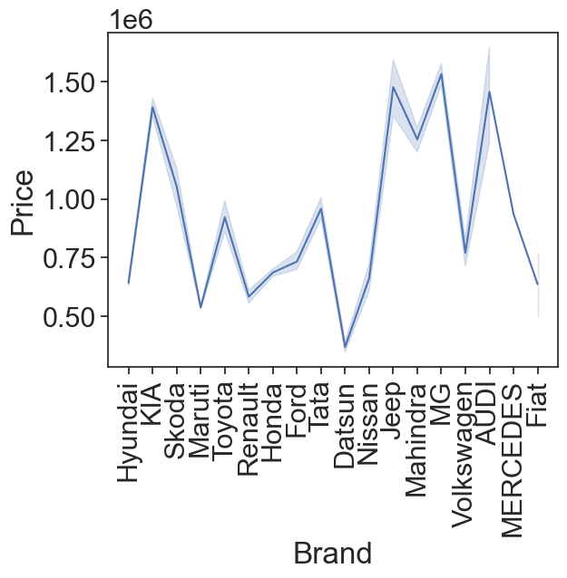
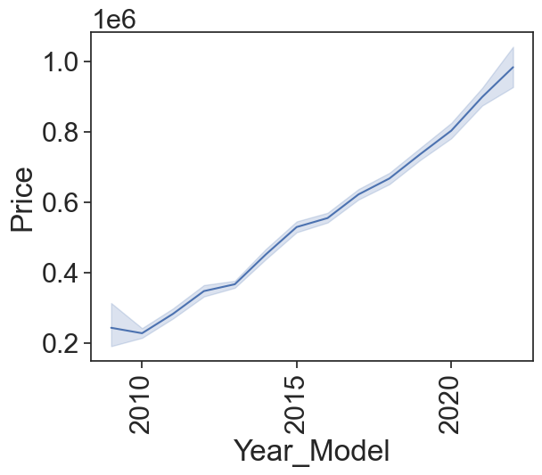
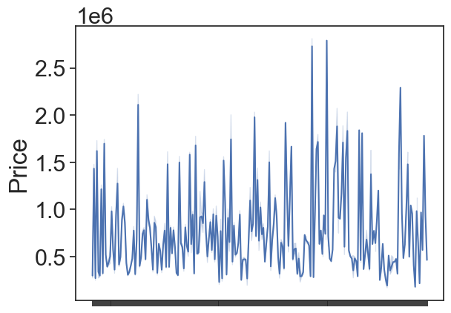
Line plot for all feature for statistical summary

Slide 38
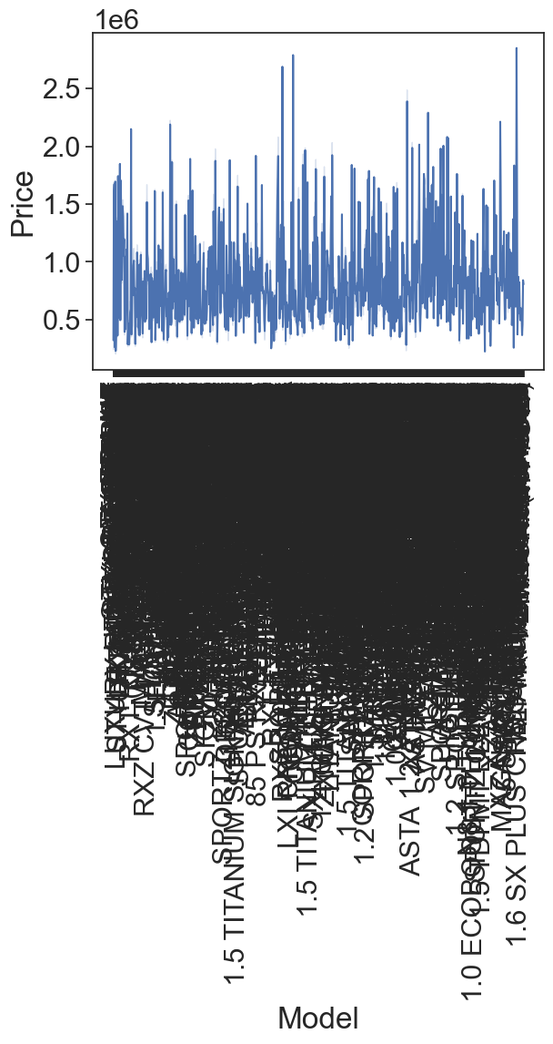
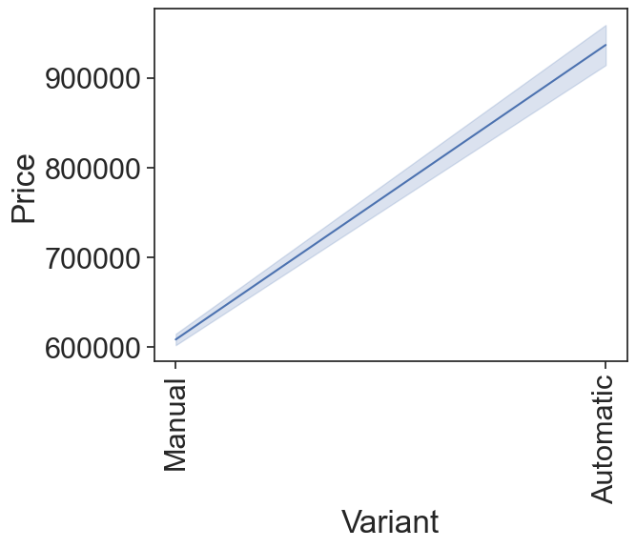

Slide 39
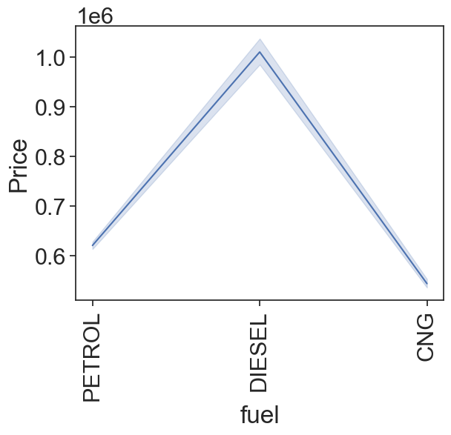
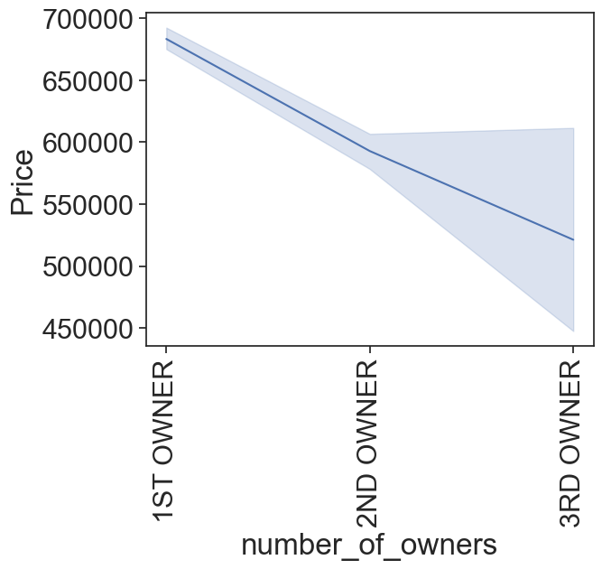

Slide 40
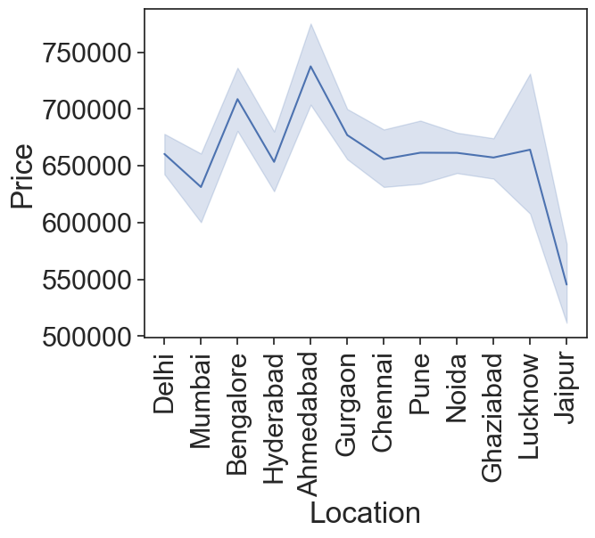
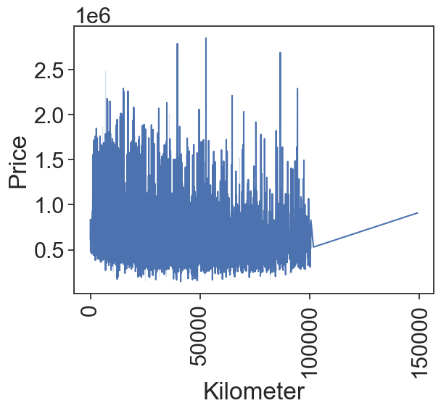
We can see that Model and Car_Name has not Linear Relationship . And left all have Negative and Positive Relationship.

Slide 41
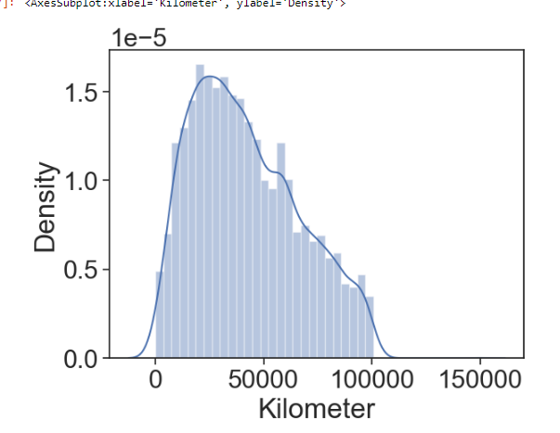
Lets plot Dist Plot for checking the Distribution
Kelometer is almost normally Distributed

Slide 42
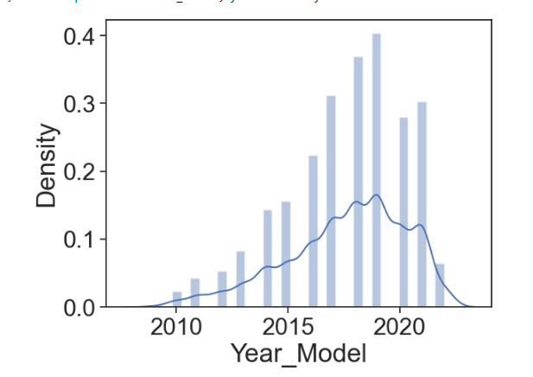
Lets plot Dist Plot for checking the Distribution
Year_Model are Left Skewed but wer take as a
Normal distribution because is a Year Column.
And in india for any motor vehicle life is 15 year
So we don’t consider as notnormal distribution

Slide 43
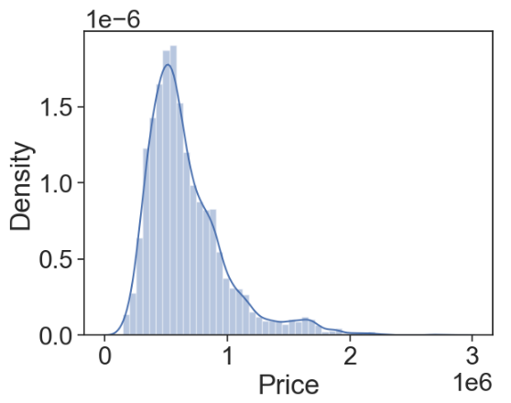
Lets plot Dist Plot for checking the Distribution
Little bit Right Skewed. But we dont have correct them because its a target column

Slide 44
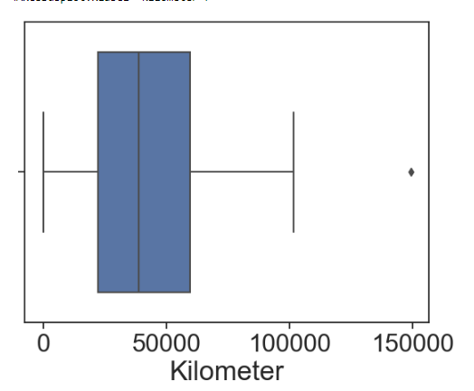
Checking outliers
We , Have outliers but we dont remove this because we consider 150000 KM any car can run

Slide 45
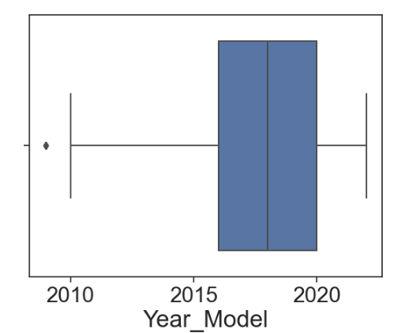
Here , We have outlers . but we dont consider as a outlier beacuse beacuse 2010 model car are running in road . beacuse in india any motor vehicle life is for 15 Year.

Slide 46
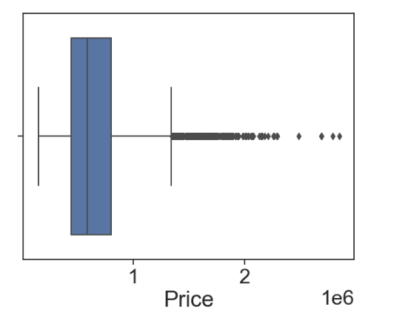
We, Have outlier but we dont correct them because we its a target column.

Slide 47
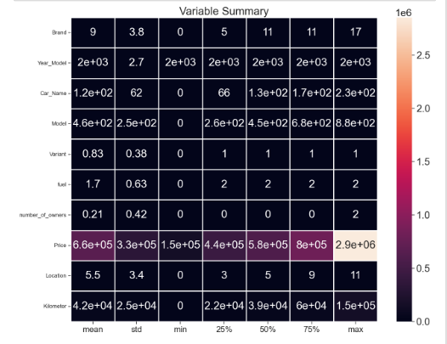
Data Preprocessing
Describe the dataset.

Slide 48
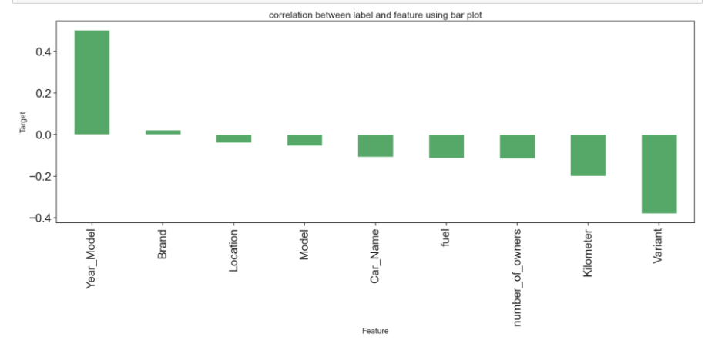
Lets check correlation with target

Slide 49
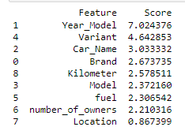
Feature Selection by kbest
Here, We can find all the columns contributing in the model building. So we not
Going to delete any of the feature.

Slide 50
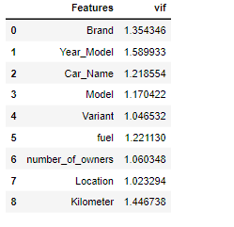
VIF FOR MULTICOLLINEARITY
Here we set threshold for 10 and all the feature
Comes in range . So here we can say that there is
Not multicollinearity problem

Slide 51
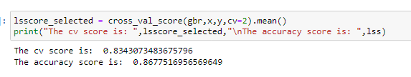
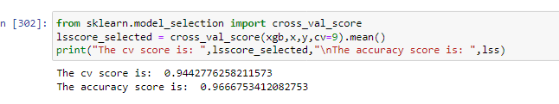
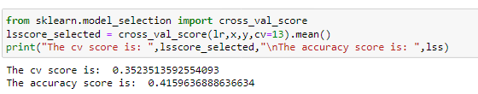

Lets build model
Gradient Boosting Regressor ->
XGB ->
Linear Regression ->
Random Forest ->

Slide 52
Model Selection
So, Here we using four algorithm . And we can see tha three algorithms gives good accuracy and linear regression is not giving good accurany . And we also check for cross validation . For all algo. And after making all model we select as a best model XGB Because XGB Gives us 96 % accuracy and CV Score Give us 94% and its very good for any prediction.
So we are going to tune the parameter of XGB and checking our model is overfitted or not . And for that I am goint to use Gridsearchcv. And tune the all parameter and try to increase our accuracy,

Slide 53
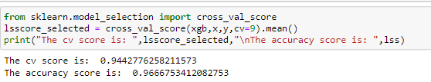
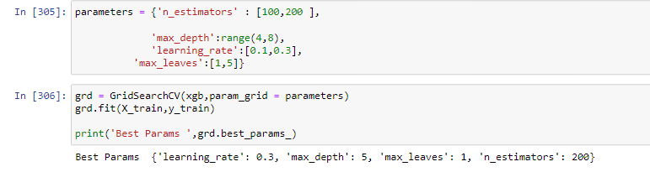
Hyperparameter tuning
XGB ->
Lets do Hyperparameter Tuning.

Slide 54
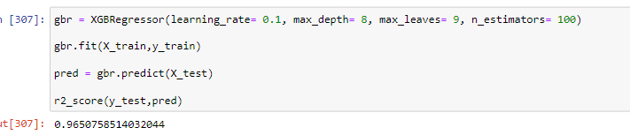
Final model
So, Here We try to increase our accuracy using GridSearchCV But we don’t . Atleast here we
Confirm that our model is not overfitted . And we good to go in Production

Slide 55

Best fit line
Here , We can see that Our most of
The poins come very close to the
Best fit line. Its meaning is our model
Is good

Slide 56
Conclusion
As you can see in slide number 15 and 16 . We getiing the info if the seller has to focus on Maruti , Hyundai , Tata ,Mahindra and Honda Because Most of the Indian Family Is Middile Class and Those Company I Mentioned they are Making Mid Ranges Car So its easy to capture market .
Most of the second hand car sell in price between 1.5 Lakh to 6 Lakhs Rupees.
Costly Car Sell From Toyota (Fortuner, Innova Crysta, ) , Audi (Q3). And etc . Follow the 15 , 16 Slide .

Slide 57
All the Information of Car Details from taken from car24.com . We are scraping the data then we manipulate the data using pandas , for visualization we use seaborn and matplotlib , and Build Machine Learning Model..
Programming Language -> Python.

Slide 58
Thankyou

